Slide 1
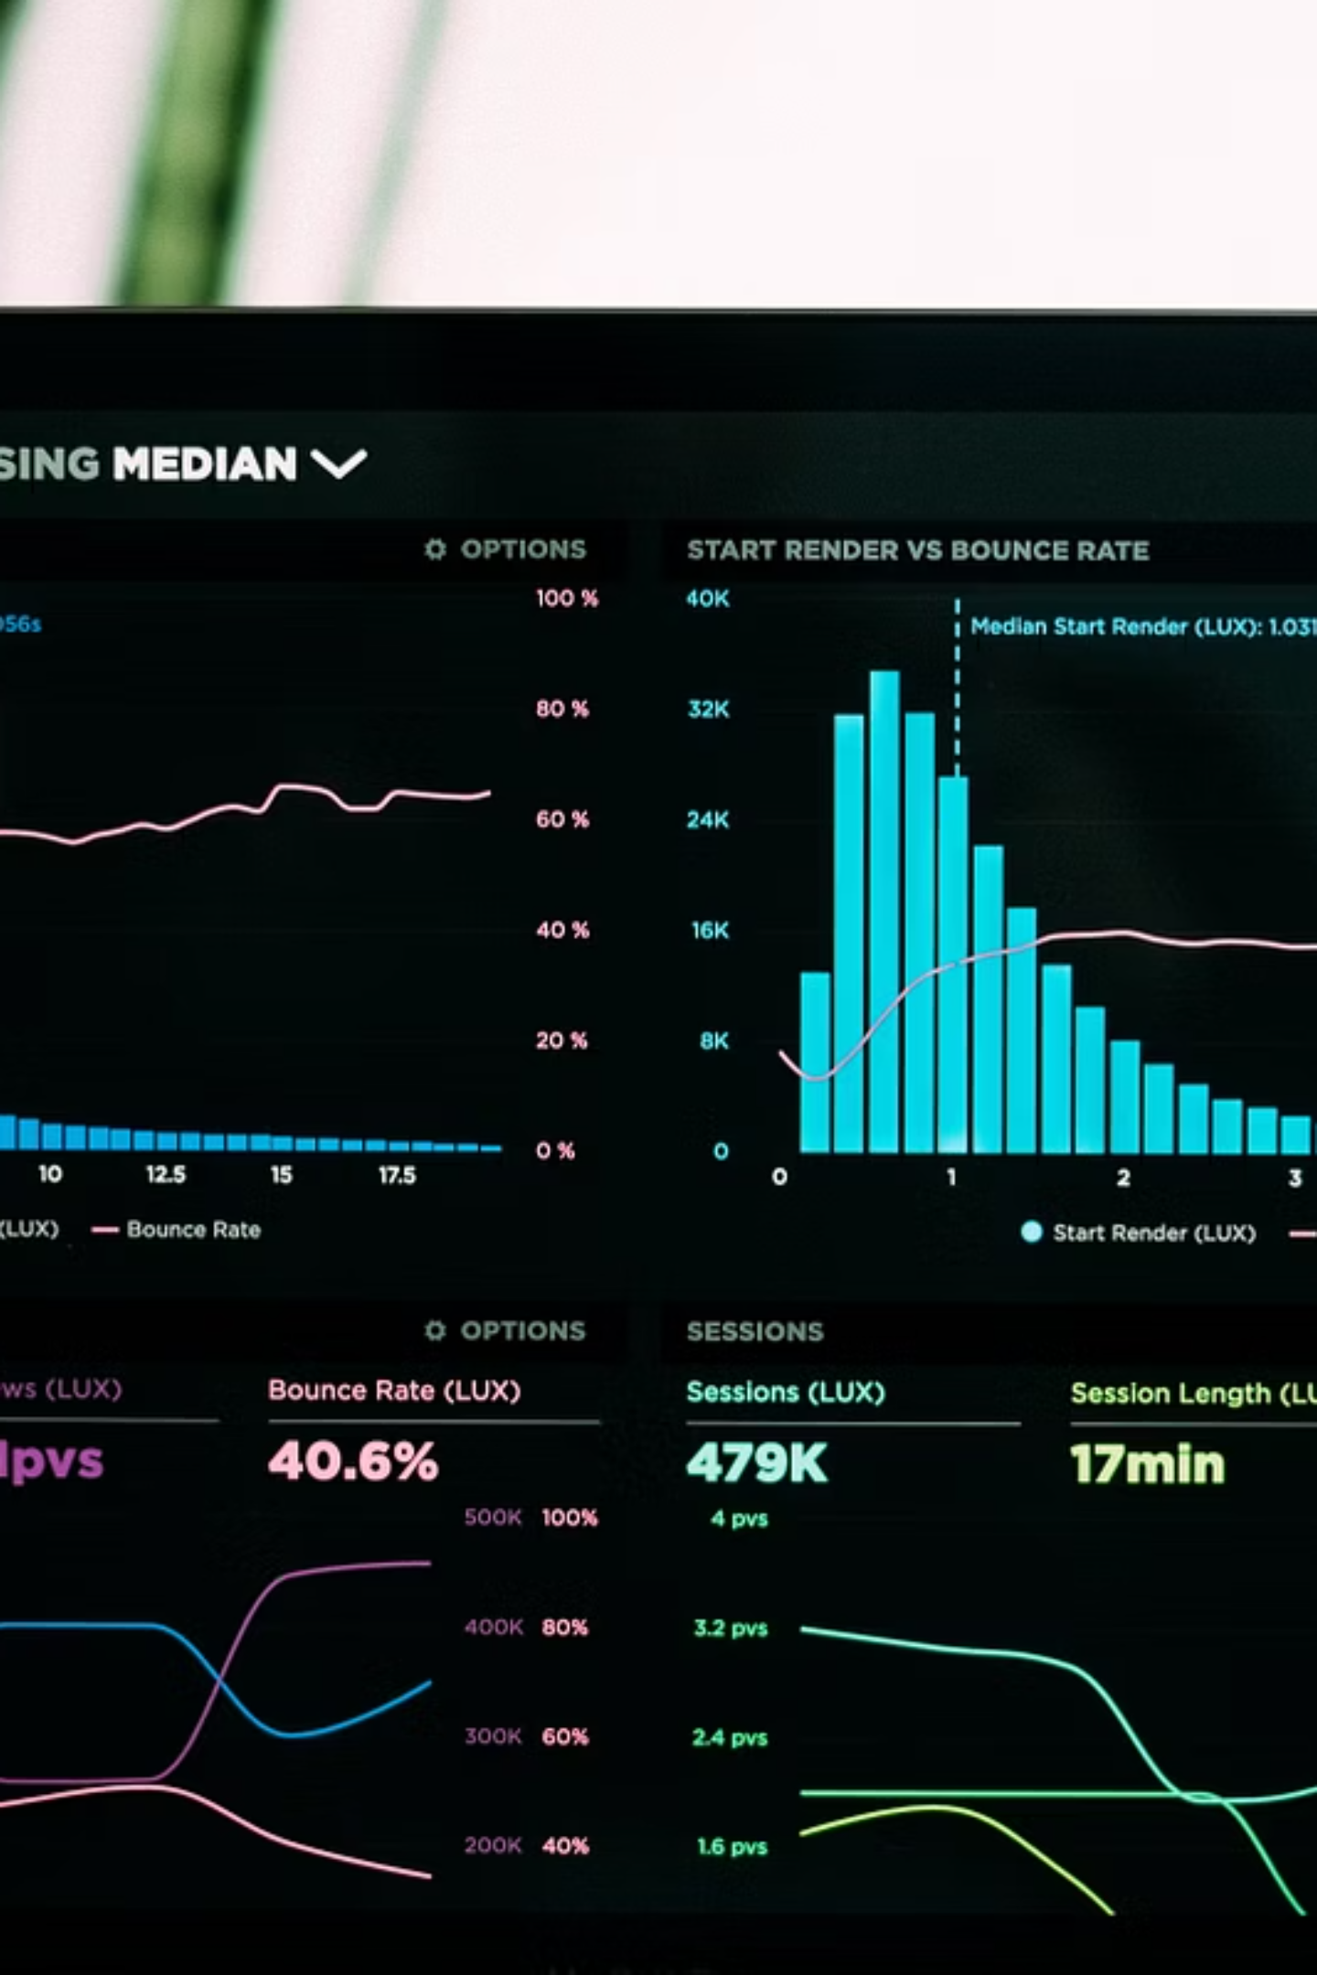
Python for
Data Science

Slide 2

What is Programming?
Definition
Programming is giving instructions to a computer to perform specific tasks. Think of it like writing a recipe or giving directions to someone. You tell the computer exactly what to do, step by step, and it follows your instructions precisely.
Every app, website, and game you use was created using programming languages. Without programming, computers would be useless machines!
Like a Recipe
Building Blocks
Just as a recipe tells you step-by-step how to cook a meal, code tells the computer how to solve a problem.
Programming uses small, simple instructions that you combine to create complex programs.
Creative Problem-Solving
Programming lets you create solutions to real problems and build things that never existed before!

Slide 3

What is Python?
01
02
Created in 1991
Named After Comedy
Developed by Guido van Rossum in the Netherlands
Actually named after Monty Python's Flying Circus, not the snake!
03
Grows Every Year
Now one of the most popular programming languages in the world
Key Features
Why Python is Beginner-Friendly
Easy to read and write - looks almost like English
Free and open-source software
Works on Windows, Mac, and Linux
Huge community of users and helpers
Thousands of libraries for different tasks
Python uses simple, clear syntax that's easy to understand. You don't need to memorize complex rules or write complicated code. Python focuses on making programming accessible to everyone, which is why it's the perfect first language to learn!

Slide 4
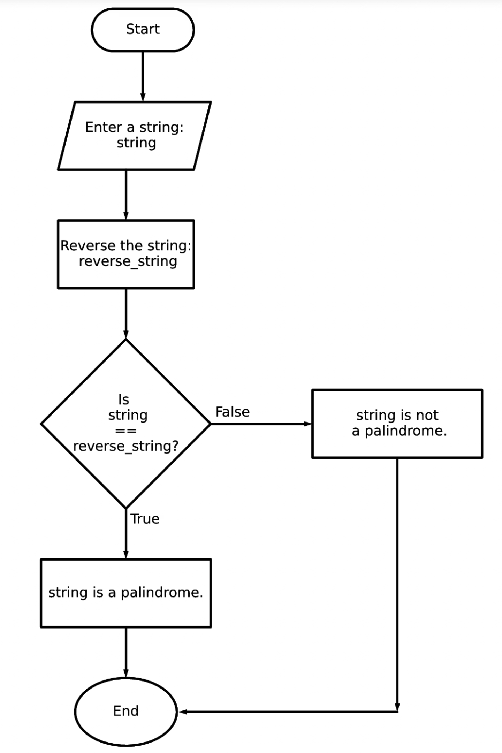
Why Python for Data Science?
Simplicity
Write less code to do more. Python's clean syntax lets you focus on solving problems instead of struggling with complex programming rules. Perfect for beginners!
Powerful Libraries
Get access to specialized tools like Pandas, NumPy, and Matplotlib that make data analysis easy. These libraries save you from writing everything from scratch.
Data Analysis
Analyze large datasets quickly and easily. Python can handle thousands or millions of data points with just a few lines of code.
Machine Learning & AI
Build intelligent systems that can learn from data. Libraries like TensorFlow and Scikit-learn make advanced AI accessible to beginners.

Slide 5
Python vs Other Programming Languages
Let's see how Python compares to other popular languages you might have heard about:
Feature
Python
Java
C++
Difficulty
Easy
Moderate
Hard
Code Length
Short
Long
Very Long
Speed
Moderate
Fast
Very Fast
Best For
Data Science, AI
Enterprise Apps
Game Development
Learning Curve
Gentle
Steeper
Steepest
Python vs R
The Verdict
R is great for statistics but harder to learn. Python is more versatile and easier for beginners. For data science, Python is often the better choice!
Python wins for beginners because it's the easiest to learn while still being powerful enough for professional work.

Slide 6

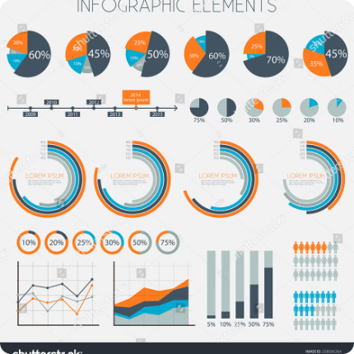

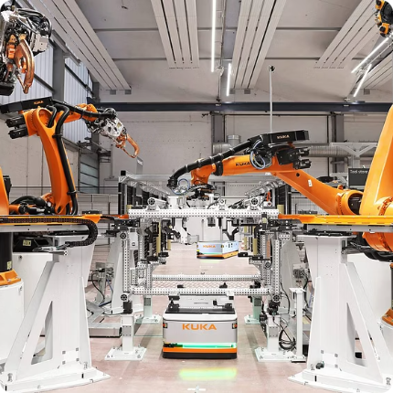



Real-World Applications of Python
Python is everywhere! From the apps on your phone to the websites you visit, Python powers countless technologies we use every day.
Artificial Intelligence
Data Science
Web Development
Automation
AI assistants, chatbots, and smart systems all use Python to learn and make decisions.
Companies analyze customer data, sales trends, and market research using Python.
Popular websites like YouTube, Instagram, and Spotify use Python for their backend.
Automatically process files, send emails, and handle repetitive tasks with Python scripts.
Cybersecurity
Game Development
Security experts use Python to test systems, find vulnerabilities, and protect networks.
Build games and interactive experiences using Python libraries like Pygame.
"Python is used by NASA, Google, Netflix, and Instagram. If these companies trust Python, you can too!"

Slide 7




Introduction to Jupyter Notebook
What is Jupyter Notebook?
Jupyter Notebook is a special tool that lets you write and run Python code in your web browser. It's perfect for learning because you can see your results immediately and mix code with explanations and pictures.
Think of it like a digital science notebook where you can write experiments (code), see results, and take notes all in one place!
Key Features
Write code in "cells" and run each one separately
See results instantly below your code
Add text explanations and headings
Include charts and images in your notebook
Save your work and come back later
Create
Write Code
Start a new notebook file
Type Python in code cells
Run
See Results
Click "Run" to execute code
View output immediately

Slide 8

Introduction to Google Colab
What is Google Colab?
Colab vs Jupyter
Google Colab is like Jupyter Notebook but it runs completely in your web browser for free! No installation needed. It's hosted by Google, so you can access your work from any computer.
Similarities:
Both use notebook format
Same code syntax
Can run Python code
Support text and code cells
Advantages of Colab
Free to use - no cost whatsoever
No installation required
Works on any computer with a browser
Access to free computing power
Easy sharing with classmates
Saves automatically to Google Drive
Differences:
Colab is cloud-based, Jupyter is local
Colab requires internet, Jupyter doesn't
Colab is free, Jupyter needs installation
Colab has GPU support for free
Getting Started with Colab
Go to colab.research.google.com, click "New Notebook," and start coding! It's that simple. No downloads, no installations, just pure coding fun.

Slide 9
Installing Python
Ready to start coding? Here's how to set up Python on your computer:
Run Installer
Download Python
Open the downloaded file and click "Install Now." Make sure to check "Add Python to PATH" during installation.
Visit python.org and download the latest version. Click the big yellow download button - it's super easy!
Verify Installation
Install Code Editor
Open Command Prompt and type python --version. If you see a version number, congratulations! Python is installed.
Download Visual Studio Code (free) or install Jupyter Notebook using the command: pip install jupyter
Recommended Setup
Alternative: Use Online
For beginners, we recommend:
Don't want to install anything? Use Google Colab or Replit online. They work great for learning and don't require any installation!
Python 3.11 or later
Visual Studio Code (free)
Jupyter Notebook extension
Python extension for VS Code

Slide 10
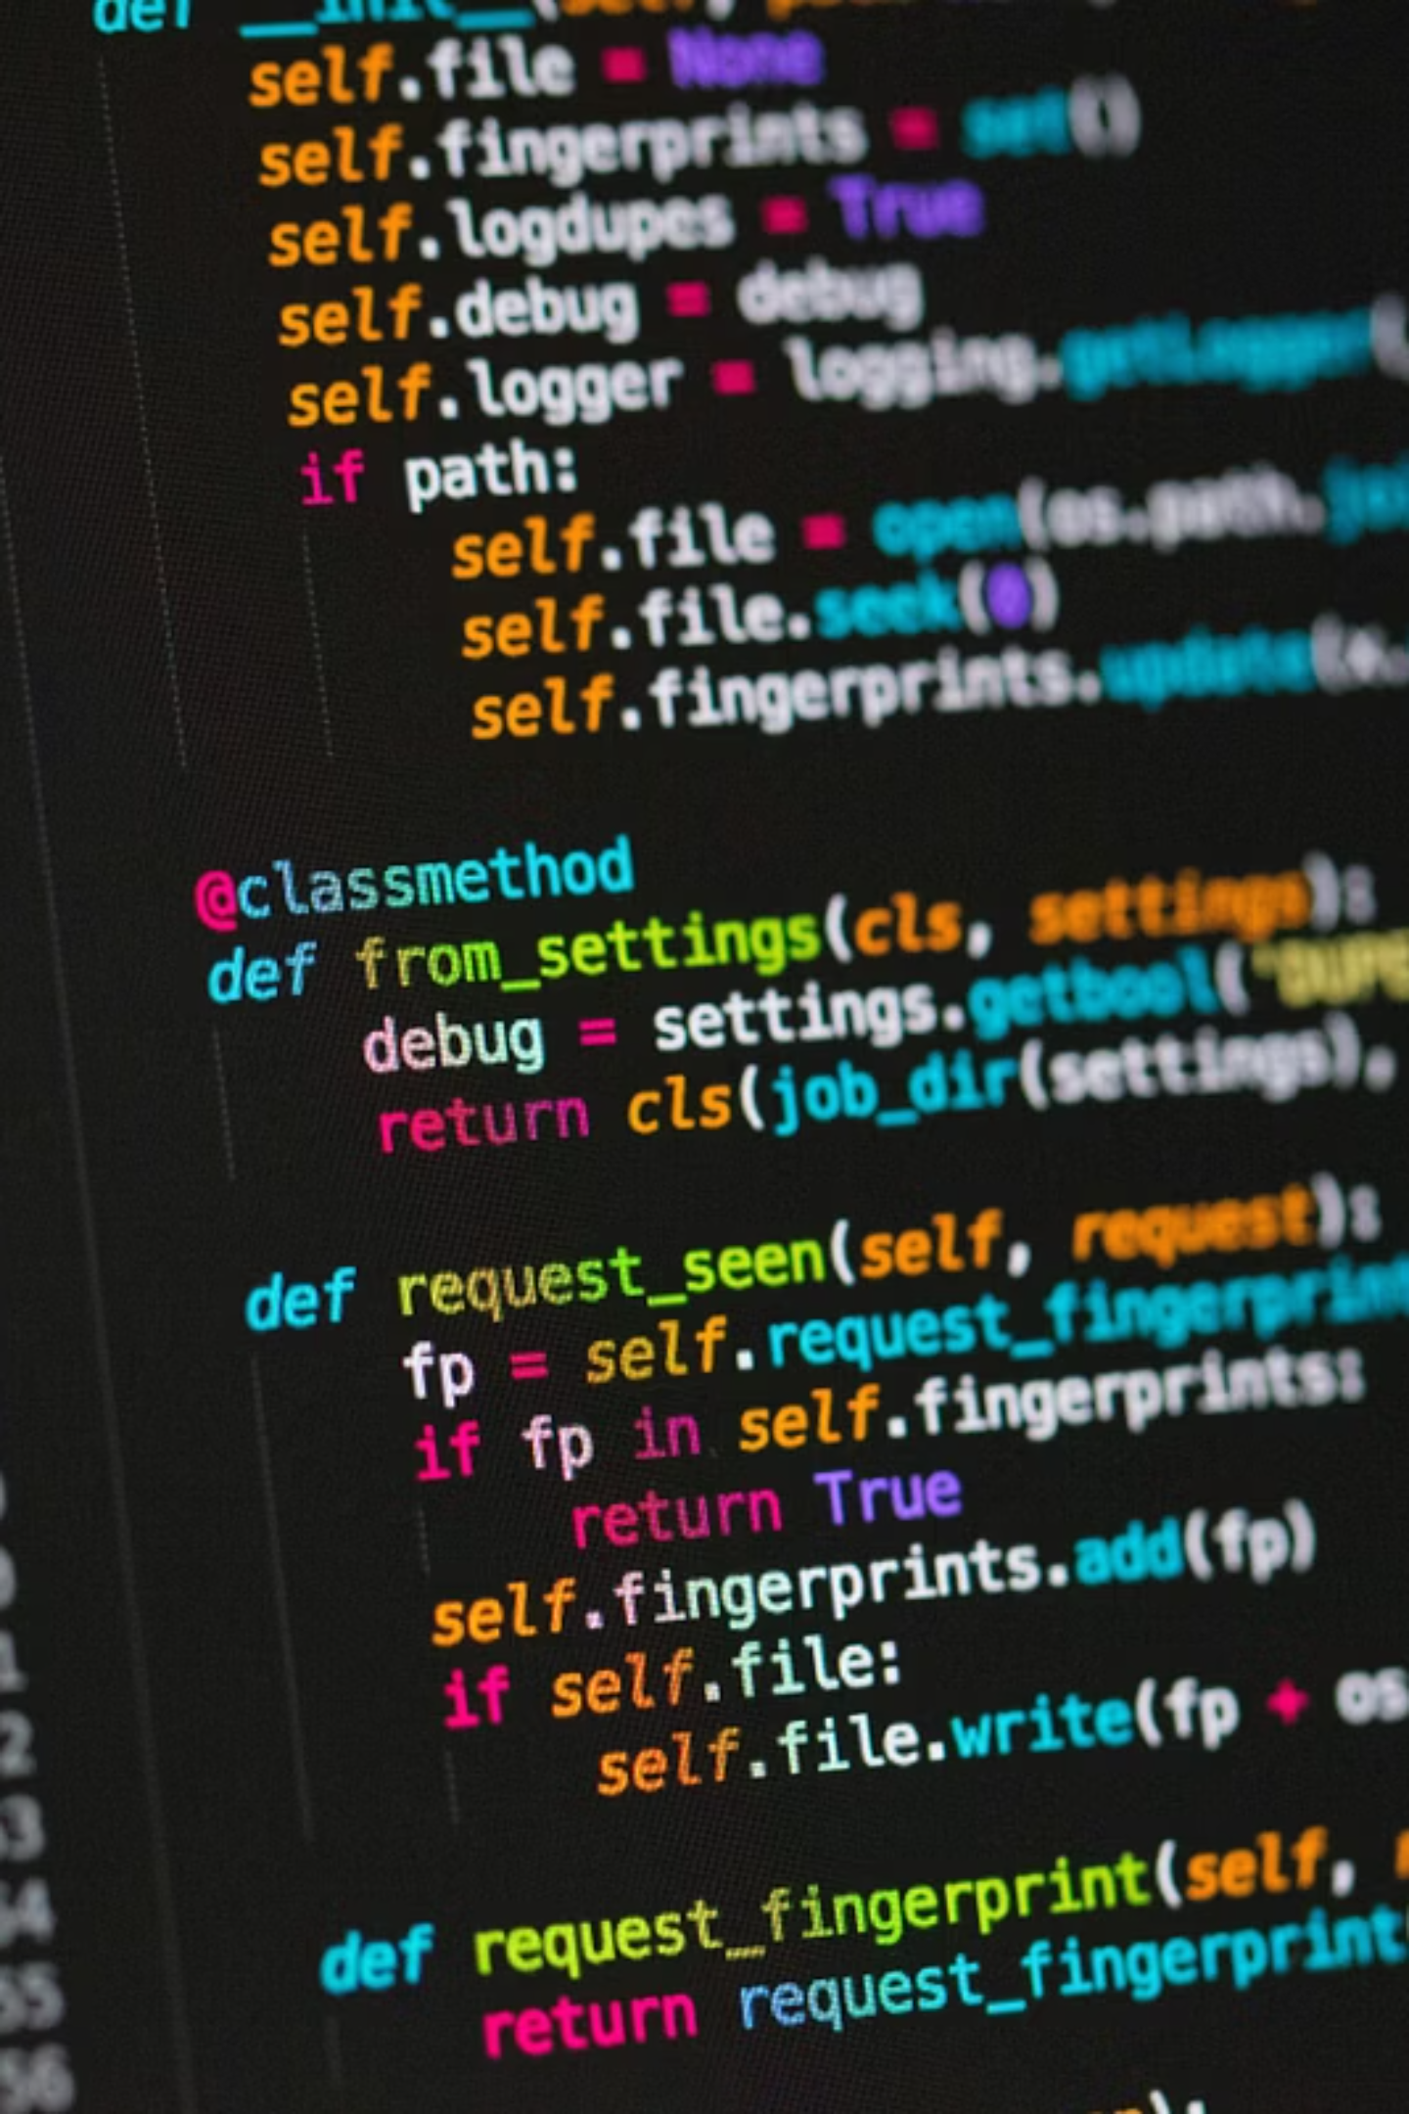
Writing Your First Python Program
Every programming journey starts with a simple "Hello, World!" Let's write our first program and understand what makes it work.
01
Create a New File
Open a text editor or Python IDE and create a file called hello.py
02
Write the Code
Type: print("Hello, World!")
03
Run the Program
Execute the file using Python interpreter
04
See the Output
Watch "Hello, World!" appear on your screen

Slide 11

Understanding the print() Statement
The print() function is your first tool for communicating with the computer. It displays information to the screen, helping you see what your program is doing.
Basic Syntax
Common Mistakes
Forgetting quotes around text
Mismatching quotation marks
Missing parentheses
Using capital P in Print
print("Your message here")
print(variable_name)
Examples
print("Welcome to Python!")
print("Data Science is awesome!")
💡 Pro Tip: The print() function is essential for debugging your code. Use it frequently to see what your program is doing at each step!

Slide 12
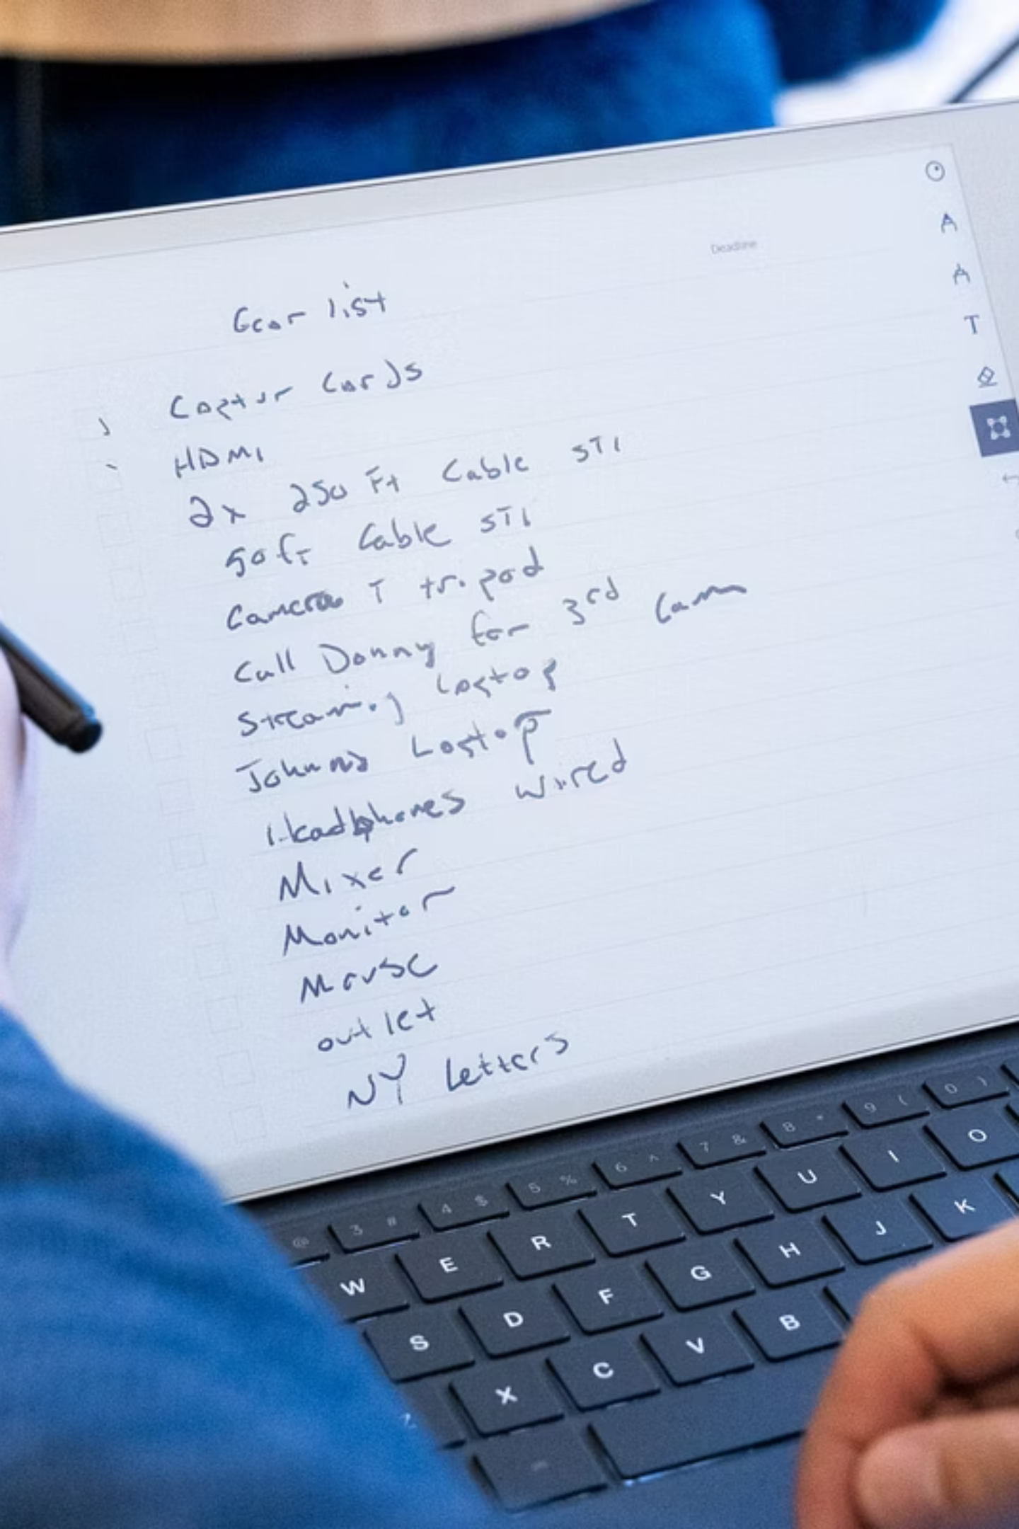
Comments in Python
Comments are notes in your code that the computer ignores. They help you and others understand what the code does. Think of them as sticky notes explaining your thought process.
Single-Line Comments
# This is a comment
print("Hello") # Comments can be inline
Use # symbol to comment out a single line
Multi-Line Comments
"""
This is a multi-line comment
that spans multiple lines
"""
'''
Another way to write
multi-line comments
'''
Use triple quotes for block comments
Why Comments Matter
Explain complex logic to yourself and others
Temporarily disable code without deleting it
Document what each part of your program does
Make your code easier to maintain and update

Slide 13
Variables in Python
Variables are containers that store data. Think of them like labeled boxes where you can keep information and retrieve it later. They're fundamental to programming because they let your programs remember and work with data.
What Are Variables?
Real-Life Analogy
Variables store data that can be used and changed throughout your program. They're like containers with labels that hold information.
Imagine variables as labeled storage bins at a warehouse. The label tells you what's inside, and you can put different items in each bin as needed.
message = "Hello, Python!"
number = 42
price = 19.99
Variable Naming Rules
Good Practices
Start with a letter or underscore
Use letters, numbers, and underscores
Case-sensitive (age ≠ Age)
Avoid Python keywords
Use descriptive names
Follow snake_case convention
Make names readable
Be consistent

Slide 14
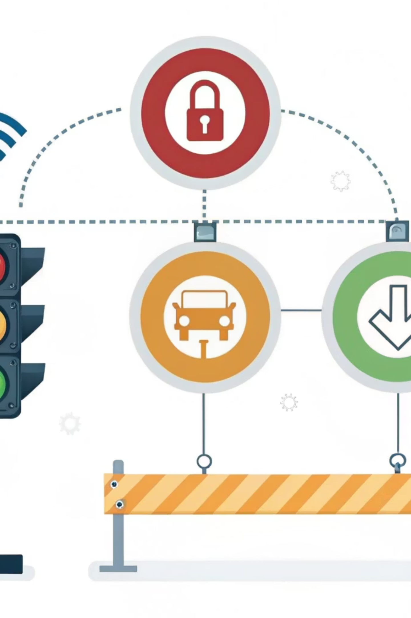

Variable Naming: Valid vs Invalid
Choosing the right variable names is crucial. Python has specific rules about what names are allowed. Let's see examples of good and bad choices.
✅ Valid Variable Names
❌ Invalid Variable Names
user_name
total_score
age
_private_var
num1
first_name
1st_name (starts with number)
user-name (uses hyphen)
class (Python keyword)
my var (contains space)
first-name (uses hyphen)
⚠️ Common Mistake: Using Python reserved keywords as variable names will cause errors. Examples include: class, def, if, while, for, and, or, not, True, False, None.

Slide 15
Data Types in Python
Data types define what kind of information a variable can store. Think of them as different categories: numbers, text, true/false values, and more. Each type determines what operations you can perform with the data.
int (Integer)
float (Floating-Point)
str (String)
Whole numbers, positive or negative, without decimals. Examples: 5, -3, 42, 1000
Numbers with decimal points. Examples: 3.14, -0.5, 2.0
Text enclosed in quotes. Examples: "Hello", "Python", "Data Science"
bool (Boolean)
NoneType
True or False values. Used for logical operations and conditions.
Represents the absence of value. Similar to "null" in other languages.

Slide 16




The type() Function
The type() function is your detective tool—it tells you what kind of data you're working with. This is crucial for debugging and ensuring your program works correctly.
Check Data Type
Use type() to identify what type of data a variable contains
Prevent Errors
Knowing data types helps avoid type-related programming mistakes
Debug Code
Quickly verify if variables contain expected data during program execution
Examples in Action
name = "Alice"
age = 25
gpa = 3.8
is_student = True
nothing = None
print(type(name)) #
print(type(age)) #
print(type(gpa)) #
print(type(is_student))#
print(type(nothing)) #

Slide 17
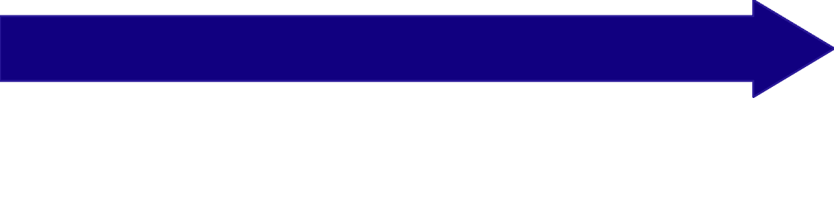

Input and Output in Python
So far we've only sent information to the computer using print(). Now let's learn how to receive input from users! The input() function pauses your program and waits for the user to type something.
Data Stored in Variable
User Types Response
User's input is saved and can be used later in the program
Call input() Function
Program waits for keyboard input and Enter key press
user_name = input("Enter your name: ")
Simple Example
Mini Calculator
name = input("What's your name? ")
print("Hello, " + name + "!")
num1 = float(input("Enter first number: "))
num2 = float(input("Enter second number: "))
result = num1 + num2
print("Sum:", result)
Output:
What's your name? Bob
Hello, Bob!
💡 Important Note: input() always returns a string, even if the user types a number. You'll need to convert it using type casting (next section)!

Slide 18
Type Casting in Python
Type casting converts data from one type to another. This is essential when working with user input or when you need to perform specific operations that require certain data types.
int()
float()
str()
Converts to integer
Converts to float
Converts to string
int("5") # 5
int(3.7) # 3
float("3.14") # 3.14
float(5) # 5.0
str(42) # "42"
str(3.14) # "3.14"
Why Type Conversion Matters
Without type casting, you cannot perform mathematical operations on user input since input() always returns a string. Trying to add "5" + "3" gives "53" (string concatenation) instead of 8 (mathematical addition).
Common Scenario
Error Handling
What if user enters text instead of a number? We'll learn error handling in later lessons!
age = input("Your age: ")
age = int(age) # Convert to integer
years_to_18 = 18 - age

Slide 19
Getting Started: Python Arithmetic Operators
Arithmetic operators are the building blocks of programming. They let you perform mathematical calculations just like you do in math class, but using code!
+
-
Addition: Adds two numbers together
Subtraction: Subtracts one number from another
*
/
Multiplication: Multiplies two numbers
Division: Divides one number by another

Slide 20
More Arithmetic Operators
Exponentiation (**)
Integer Division (//)
Modulus (%)
Returns the remainder after division. Great for checking if numbers are even or odd!
Raises a number to a power. For example, 2**3 means 2³ = 8.
Divides and returns the whole number only, discarding any remainder.
print(2**3) # Output: 8
print(5**2) # Output: 25
print(7%2) # Output: 1
print(10%3) # Output: 1
print(7//2) # Output: 3
print(10//3) # Output: 3

Slide 21
Real-World Examples: Arithmetic in Action
1
2
3
Shopping Calculator
Grade Average
Distance Conversion
Calculate the total cost of items in your shopping cart:
Find the average of your test scores:
Convert miles to kilometers (1 mile = 1.609 km):
test1 = 85
test2 = 92
test3 = 78
average = (test1 + test2 + test3) / 3
print(average) # Output: 85.0
price1 = 15.99
price2 = 23.50
price3 = 8.75
total = price1 + price2 + price3
print(total) # Output: 48.24
miles = 10
km = miles * 1.609
print(km) # Output: 16.09

Slide 22

Comparison Operators
Comparison operators compare two values and return True or False. These are essential for making decisions in your programs!
== (Equal To)
!= (Not Equal To)
> (Greater Than)
Checks if two values are exactly the same
Checks if two values are different
Checks if left value is larger
print(5 != 3) # True
print(5 != 5) # False
print(7 > 5) # True
print(5 > 7) # False
print(5 == 5) # True
print(5 == 3) # False

Slide 23
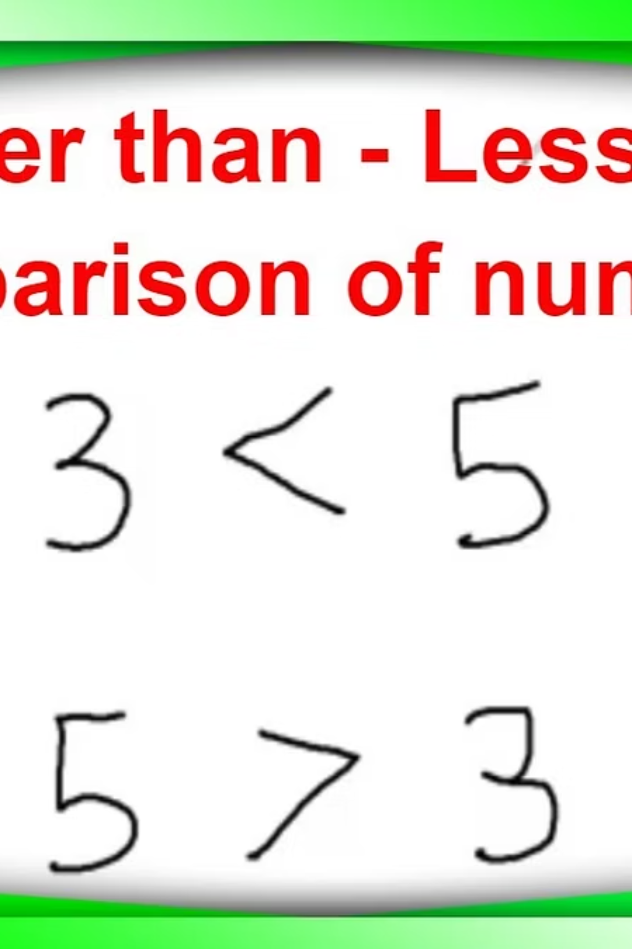
More Comparison Operators
< (Less Than)
>= (Greater Than or Equal)
Checks if left value is smaller
Checks if left value is larger or equal
print(3 < 5) # True
print(5 < 3) # False
print(5 >= 5) # True
print(6 >= 5) # True
print(4 >= 5) # False
<= (Less Than or Equal)
Checks if left value is smaller or equal
print(5 <= 5) # True
print(4 <= 5) # True
print(6 <= 5) # False

Slide 24
Logical Operators
Logical operators combine multiple conditions. They're like the "and," "or," and "not" words you use in everyday conversation, but for programming!
and
or
not
Both conditions must be True
At least one condition must be True
Reverses the result

Slide 25
Truth Tables Explained
Truth tables show all possible outcomes when using logical operators. Understanding these will help you write better code!
AND Truth Table
A
B
A and B
True
True
True
True
False
False
False
True
False
False
False
False
OR Truth Table
A
B
A or B
True
True
True
True
False
True
False
True
True
False
False
False

Slide 26
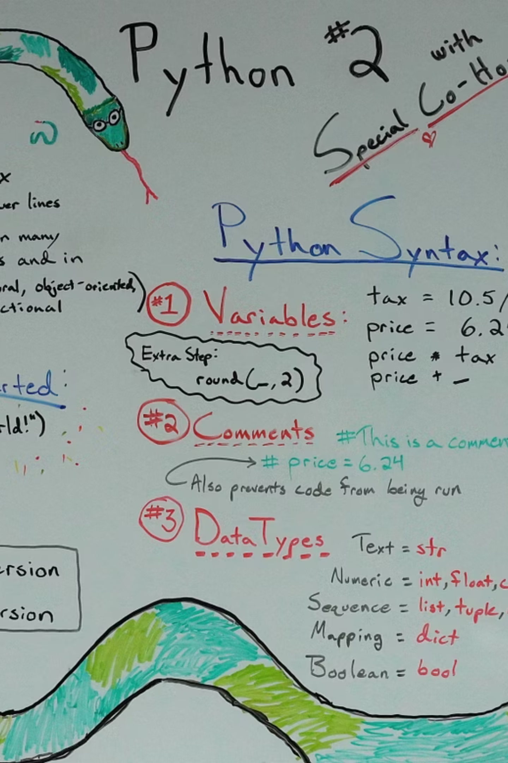
Assignment Operators
Assignment operators are shortcuts that let you perform an operation and assign the result to a variable in one concise step.
+= (Add and Assign)
-= (Subtract and Assign)
*= (Multiply and Assign)
Adds the value of the right operand to the left operand and assigns the result to the left operand.
Subtracts the value of the right operand from the left operand and assigns the result to the left operand.
Multiplies the left operand by the value of the right operand and assigns the result to the left operand.
x = 5
x += 3 # Equivalent to x = x + 3
print(x) # Output: 8
y = 10
y -= 4 # Equivalent to y = y - 4
print(y) # Output: 6
z = 2
z *= 6 # Equivalent to z = z * 6
print(z) # Output: 12

Slide 27

Common Errors Beginners Make
Encountering errors is a natural part of learning to code. Understanding these common Python errors will help you debug faster and write more robust programs.
SyntaxError
IndentationError
NameError
Happens when Python's grammar rules are broken (e.g., missing a parenthesis).
Python uses consistent indentation to define code blocks. Incorrect spacing causes this error.
Occurs when you try to use a variable or function that hasn't been defined.
# Bad
print("Hello"
# Good
print("Hello")
# Bad
if True:
print("True")
# Good
if True:
print("True")
# Bad
print(my_variable)
# Good
my_variable = 10
print(my_variable)
TypeError
Results from trying to perform an operation on an inappropriate data type (e.g., adding a number to text).
# Bad
print("Hello" + 5)
# Good
print("Hello" + " World")
print("Number: " + str(5))
Solution: Always read the error message! It often points directly to the line of code and the type of problem.

Slide 28
Quick Revision

Slide 29

Python Basics Revision
Python is a high-level, general-purpose programming language known for its simplicity and readability. It's perfect for data science because of its extensive libraries and active community support.
What is Python?
Why Python for Data Science?
Jupyter & Colab
A beginner-friendly, versatile programming language that emphasizes code readability with its clean syntax and indentation.
Rich ecosystem of libraries (NumPy, pandas, matplotlib), excellent for data manipulation, analysis, and visualization tasks.
Interactive environments for writing and testing code. Jupyter runs locally, while Google Colab offers cloud-based notebooks.
First Python Program
# This is a comment
print("Hello, World!")
# Output: Hello, World!
print() displays output to the console. # creates comments ignored by Python.

Slide 30
Variables and Data Types
Variables store data that can be used and modified throughout your program. Think of them as labeled containers holding information.
int – Integers
float – Decimals
str – Strings
Whole numbers, positive or negative, without decimals.
Numbers with decimal points for precise calculations.
Text enclosed in quotes (single or double).
price = 29.99
temperature = -3.5
name = "Alice"
message = 'Hello!'
age = 25
score = -10
bool – Booleans
NoneType
True or False values for logical operations.
Represents absence of value or null.
is_active = True
is_done = False
user = None
result = None
Variable Rules
Helpful Functions
Use letters, numbers, underscores
Start with letter or underscore
Case-sensitive (age ≠ Age)
Avoid Python keywords
type(variable) # Check data type
input("Text: ") # Get user input
int(), float(), str() # Type casting

Slide 31

Operators Quick Reference
Operators perform operations on variables and values. They're essential for calculations, comparisons, and controlling program flow.
Arithmetic Operators
Comparison Operators
Perform mathematical calculations:
Compare values and return True/False:
+ Addition
- Subtraction
* Multiplication
/ Division
** Exponent
% Modulus (remainder)
== Equal to
!= Not equal
< Less than
> Greater than
<= Less/equal
>= Greater/equal
Logical Operators
Assignment Operators
Combine conditions:
Assign values to variables:
and Both must be True
or At least one must be True
not Inverts the result
= Simple assignment
+= Add and assign
-= Subtract and assign
*= Multiply and assign
Real-World Analogy
Think of operators like a calculator for your data. Arithmetic operators are your basic math functions, comparison operators are like asking questions ("Is this bigger?"), logical operators combine multiple questions, and assignment operators store your results.

Slide 32
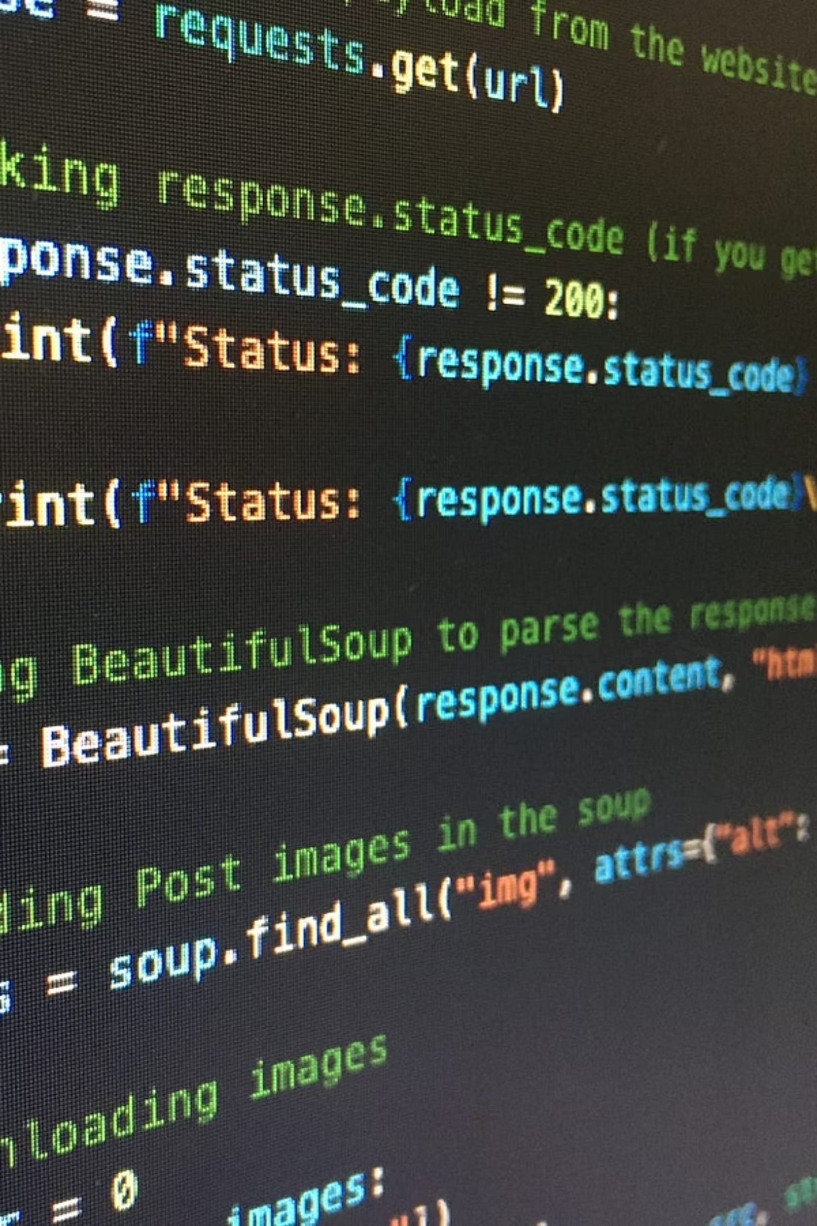
Key Takeaways
01
02
Python Basics
Variables & Data Types
Python is simple, readable, and perfect for data science with powerful libraries. Use Jupyter or Colab to write and test your code interactively.
Variables store data using descriptive names. Master int, float, str, bool, and NoneType. Use type() to check and input() to gather user data.
03
Operators
Arithmetic for calculations, comparison for conditions, logical for combining tests, and assignment for storing results. These form the foundation of program logic.
Practice Tip: Start with small examples in Jupyter Notebook. Write the "Hello, World!" program, experiment with different data types, and try simple calculations using operators. Consistent practice builds confidence!

Slide 33
Quick Reference Cheat Sheet
Essential Python Syntax
Common Operators
# Print output
print("Hello")
# Variables
name = "Bob"
age = 20
# Data types
number = 42
decimal = 3.14
text = "Python"
active = True
# Input
user_input = input("Enter: ")
# Arithmetic
sum = 5 + 3
power = 2 ** 3
# Comparison
is_equal = (5 == 5)
is_greater = (10 > 5)
# Logical
result = (age > 18) and active
# Assignment
counter = 0
counter += 1
1
2
3
Remember Indentation
Comments Help Learning
Experiment Freely
Python uses indentation to define code blocks instead of brackets. Be consistent with spacing!
Add # comments to explain your code. It helps you and others understand what each part does.
Don't be afraid to break things! Try different values, make mistakes, and learn from error messages.

